Slide 1
Reporting
Module 10

Slide 2
Module Objectives
Upon completion of this module, you will be able to:
Create and configure compliance reports.
Create and configure custom reports.
Configure the delivery of a report via email, SMS, remote file share or stored locally on the ESM.
Create customer filters and queries within report components.
Customize a report template to match your company’s requirements.

Slide 3

Module Topics
Reporting
Out of the Box Reports
Creating Reports
Customizing Reports
Report Query Wizard
Configuring Delivery of Reports

Slide 4
Reports
The Reports option allows you to generate and view reports that show data from events and flows managed on the ESM.
You can select to design your own report or run one of the reports that is included in the ESMI, and can choose whether to send the data in PDF, HTML, or CSV format.
Generated reports can be based on auditing criteria and can be used to show compliance.
These reports can be printed or sent to an auditor as well.
Reports can be helpful in checking and monitoring your network health or operational state.
Reports allow you to check if anyone is violating policy or standards within your environment.

Slide 5
Out of Box Reports
The Out of Box Reports are divided into different categories and contain data based off of predefined compliance guidelines and their requirements.
The specific compliance reports are:
Application-Microsoft Exchange and Microsoft Windows
BASEL II
Case Management
DEM
FISMA
GLBA
HIPPA
NERC
NISPOM
PCI
Sarbanes-Oxley
And other various reports such as SOX, EU 8th, GLBA, GIODO, and ISO 27002
Notes:
Compliance reports included out of the box are listed above. Each compliance regulation has multiple reports associated with them.
Other included reports have executive level summary reports. McAfee ESMI is set up so you can add the reports you need such as compliance reports; or create your own reports using the report write interface.
You can run the reports manually, or use conditions such as the time of day, or deviation from a baseline to trigger reports automatically as well.

Slide 6
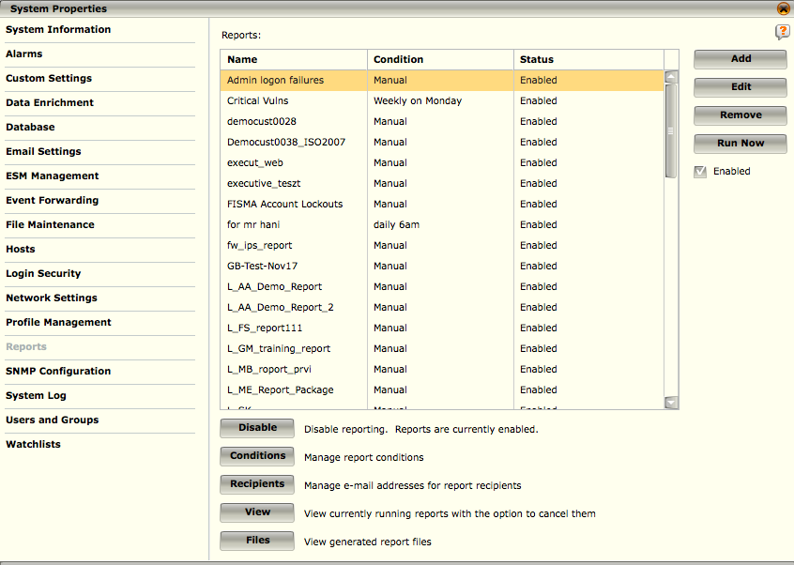
System Properties - Reports
This lists the reports that you have selected and/or created.
It allows you to add, edit, remove, and run reports that are listed, and enable and disable them.
This screen also allows you to manage the condition and recipient settings, as well as view reports that are currently being run and cancel them if necessary.
Notes:
To access reports, click on the report icon on the quick links bar in the upper right. The reporting window will appear. The reports table shows the reports you have added to your system.

Slide 7
System Properties - Reports
Add – Allows you to add pre-configured or custom reports
Edit – Allows you to edit an existing report.
Remove – Removes an existing report.
Run Now – runs the highlighted report now
Conditions – Modify or add any conditions used to generate reports.
Recipients – Manage the email recipient list.
Settings – Manages the notification settings
View – Shows currently running reports, reports are queued and run in groups
Files – Shows any reports generated that are saved to the ESM with options to manage and download the reports
Notes:
Add – This button allows you add pre-configured or custom reports to your report list.
Edit – Allows you to edit an existing report.
Remove – Removes an existing report.
Run Now – runs the highlighted report now, regardless of the conditions set to run the report.
Conditions – Modify or add any conditions used to generate reports.
Recipients – Manage the email recipient list.
Settings – Manages the notification settings (email server settings). The check box under ‘Run Now’ must be selected in order to add these settings.
View – Shows currently running reports, reports are queued and ran in groups. From this window you can see the reports which are running and cancel them if necessary.
Files – Shows any reports generated that are saved to the ESM with options to manage and download the reports.

Slide 8
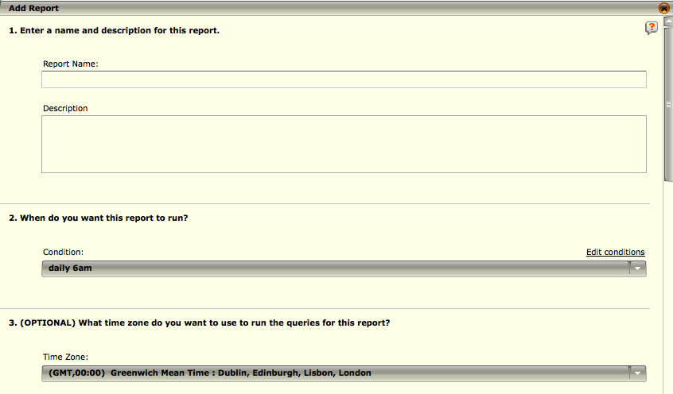
Add Report – Sections 1,2 and 3
Report Name – Enter a name for the report
Description – Enter a brief description of the report
Condition – Select when you want this report to run from the list of options on the drop-down list
Time zone - Select the time zone to be used to run the queries
Default is your time zone
NOTE
You need to configure your email settings before adding a report.
Notes:
In order to add a report, select the add button and the report writer (as above) displays.
Enter a name for the new report and a description of the information it will contain.
In the Condition field, select when you want this report to run from the list of options on the drop-down list. If you want to add a condition to the list of options, click on Edit conditions.

Slide 9
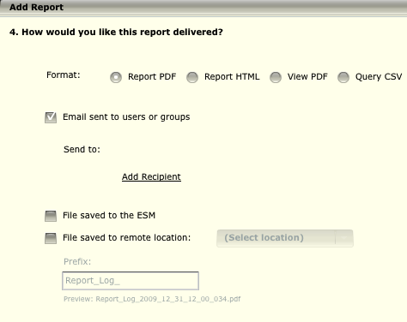
Add Report – Section 4
Format – Select the format in which you want the report sent or saved
Delivery options – Select the checkboxes for how you would like the report delivered or saved
Email: Add a list of recipients to send the report to
Save report on the ESM
Save report to remote location using a preconfigured profile
Prefix – Add a prefix to the report name when saving
Notes:
4. Select the format in which you want the report sent or saved.
If you are designing a new report, your options are PDF or HTML.
If you want to generate a PDF report based on a view, select View PDF.
Query CSV will generate a CSV file of the results of the query(ies) you select in section 5.
5. Select how you would like the report delivered. You have two options: (a) send it to users or groups and/or (b) save it to the ESM.
Email sent to users or groups - If you select this option, the Add recipient link will activate. Click on it to open the Recipients dialog and select the users or groups to whom the report will be sent.
File saved to the ESM - When you select this option, the Prefix field will activate, showing Report Log as the default prefix for the name of the file that will be generated and saved on the ESM. Change the prefix, if desired. The file name will include the prefix along with the date and time that the report is generated.

Slide 10
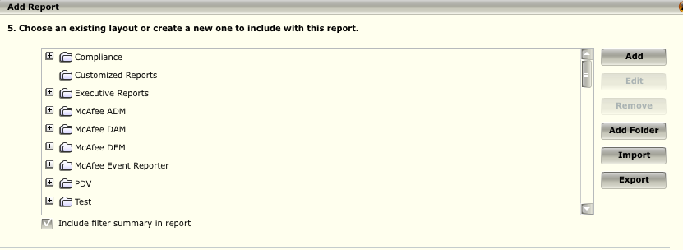
Add Report – Section 5
If you are designing a new report and selected either PDF or HTML format in previous section, you will be allowed to choose an existing layout or create a new layout for this report.
If you are generating a view PDF and selected View PDF in the previous section, you will have a drop-down list that allows you to select the view that you want to include in the report.
If you are generating a CSV file and selected Query CSV in previous section you will have a drop-down field that lists all of the available reports.
Notes:
If you are designing a new report and, therefore, selected either PDF or HTML format in Section 4, Section 5 will allow you to choose an existing layout or create a new layout for this report.
To design a new layout, click on Add. Refer to the Design a Report Layout section for details.
To select an existing layout, locate it on the list of existing reports and click on it.
To edit an existing layout, click on it then click on Edit. Refer to the Edit a Report Layout section for details.
To delete one or more existing layouts, click on them then click on Remove.
To add a folder under which you can organize your layouts, click on the Add Folder button. Enter a name for the folder in the Enter a new name field of the dialog that opens then click OK. The folder will be added to the list of layouts.
When adding a folder at root level, ensure that an existing folder or a layout in an existing folder is not selected. If an existing folder is selected, the new folder will be added as a subfolder. You can also do the following:
To add a new layout to the folder, highlight the folder and click on Add. Design the layout (see Design a Report Layout) then save it. It will be saved in the folder selected.
To add an existing layout to the folder, click on the layout then drag and drop it in the folder.
To add a subfolder to an existing folder, highlight the folder then click Add Folder, enter a name for the new folder, and click OK. The new folder will be added as a subfolder to the existing folder.
To move an existing subfolder to root level, select the subfolder then drag it to the bottom of the layout tree and drop it.
To import one or more layouts, click on the Import button and browse to the file(s) to be imported.
Continued on next page

Slide 11
Hidden
Notes:
If the layout that you are importing includes an image that currently exists on the ESM, the Import Report Layouts dialog will open informing you of this conflict and offering you the following choices:
Keep Local - Will keep the image on the ESM and delete the image from the report layout. The image on the ESM will be used for that layout.
Replace Local - Will replace the image on the ESM with the image in the report layout. Any layouts that currently use the image that you are deleting from the ESM will now use the image imported with the layout.
Rename - The image in the report layout will automatically be renamed and the layout will be imported using the image with the new name.
To export one or more of the layouts listed, click on the files and/or folders to be exported and click on Export.
To include a summary of the global and individual component filters defined for this report, click on the Include filter summary in report checkbox. The filters used in this report will then be listed at the bottom of the report. This is useful as an indication of the limits defined for the data included in the report.
• If you are generating a view PDF and, therefore, selected View PDF in Section 4, Section 5 will have a drop-down list that allows you to select the view that you want to include in the report.
• If you are generating a CSV file and, therefore, selected Query CSV in Section 4, Section 5 will have a drop-down field that lists all of the available reports.

Slide 12
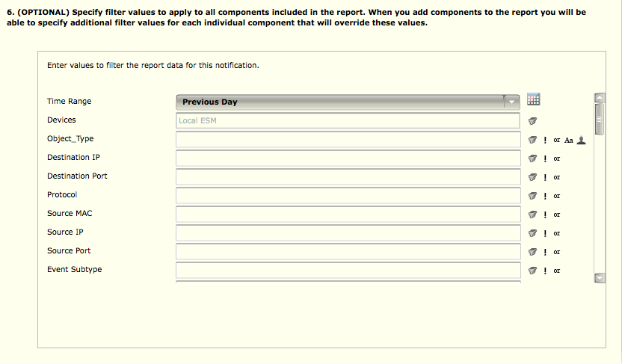
Add Report – Section 6
Allows you to define the filters to be applied to the components of a report.
If you have added any custom types, they will be displayed at the bottom of the list of filters.
NOTE
If a filter value contains commas, it must be part of a Watchlist in order to work properly.
Notes:
You can also filter on a combination of fields in one of the following ways:
To include data of more than one type, enter values in each of the appropriate fields. The data that matches all of these filters will be shown in the report.
To include some data and exclude other data, enter the filter values that you want to include and those that you want to exclude in the appropriate fields, then click the NOT icon to the right of the field values that you want to exclude. The report will include data that matches all the entries in the fields where the NOT icon was not selected, and will exclude the data that matches the values entered in the field where the NOT icon was selected.
To include data that complies with regular and either/or filters, enter the filter values in all the appropriate fields, then click the OR icon next to the fields that have the either/or values. The report will include the data that matches all the entries in the fields that were not marked OR and matches either of the values in the fields marked OR . For example, if you want to include the data that matches a specific Destination IP and Destination Port, and either a specific Source Port or a specific Source IP, enter the values in all four fields and click the OR checkbox next to Source Port and Source IP.

Slide 13
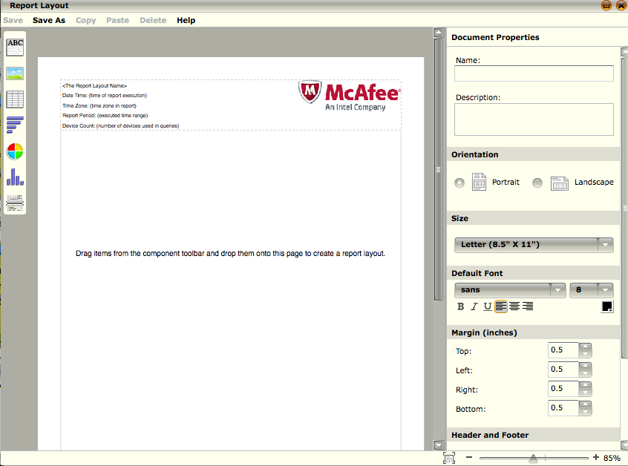
Detailed Report Layout
When you create a report, the Report Layout editor enables you to design the layout for the report.
Notes:
You can define the orientation, size, font, margins, and header and footer. In addition, you can include components such as Text, Image, Table, Bar Chart, Pie Chart, and Distribution Chart, setting them up to display the data as desired.
All layouts are saved and can be used for multiple reports. When you add a report, you are given the option to design a new layout, use an existing one as is, or use an existing one as a template and edit its features. You can also remove a report layout when it is no longer needed.
Once the report is created, save it and return to the add report screen.

Slide 14
Designing Report Layout
Text - A text box will open and the font and border properties, which can be changed, will be displayed in the Properties pane on the right.
Image - An image box will be added to the page; the Image Selector dialog will open listing any images that have been added to the Report Layout editor (e.g., if you added an image for the logo in the header); and the image and border properties, which can be changed, will be displayed in the Properties pane on the right
Table - A table box will be added to the page, the Query Wizard dialog will open and the properties you can define for the table will be displayed in the Properties pane on the right.
Bar Chart, Pie Chart, Distribution Chart - A chart box will be added to the page, the Query Wizard dialog will open, and the properties you can define for the chart will be displayed in the Properties pane on the right side of the editor
Page Break - This icon will allow you to place a page break within the report layout. When you drag it on the page, a bold black line will appear in the location where the page break will go.
Notes:
Text box – drag and drop to add a text box on the report.
Image – Add a custom image to the report.
Table – Will add a table to the report.
Bar Chart – Adds a bar chart.
Pie Chart – Adds a Pie Chart.
Distribution Graph – Adds a distribution graph using time intervals as the x-axis value.
Page break – adds a page break to the report, inserting another page to add more reports.

Slide 15
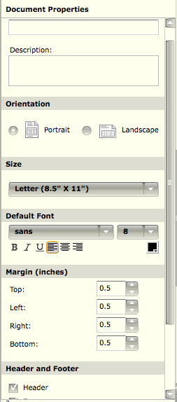
Document Properties
The right-hand frame of the report writer has options for the document properties.
The name is required, and has a 40 character limit.
Adjust the other properties as appropriate:
Description
Orientation
Size
Default Font
Margins
Header and Footer
Notes:
Enter the name for this report in the Name field. It has a limit of 40 characters.
Enter a description of the data that will be included in this report in the Description field.
Select the orientation of the page. Default is portrait, but you can select landscape by clicking on the Landscape radio button. When you change this option, the page on the editor will change its orientation to reflect what you select.
Select the size of the page. Default is Letter. When you change this option, the size of the page on the editor will change to reflect what you select.
Select the default font for the report. You will be able to set a different font for the Text, Table, Bar Chart, Pie Chart, and Distribution Chart components, if needed.
Select the type of font: sans, serif, or mono. Default is sans.
Select the font size (options are 6 to 20). Default is 8.
Select bold, italicized, or underline for emphasis.
Select whether you want the text to be justified to the left or right, or if you want it centered. Default is justified to the left.
Select the color of the font by clicking on the Font Color icon then clicking on the desired color. Default is black.
Select the size of the margins by clicking on the up or down arrows in the Top, Left, Right, and Bottom fields. Default is .5 for each. When you change the margins, the margins outlined on the editor page will reflect what you select.
Continued on next page

Slide 16
Hidden
Notes:
By default, the report will have a header and footer. If you want to delete the header and/or footer, click on the appropriate checkbox(es) in the Header and Footer section to delete the check. The header and/or footer will be deleted.
You can change the information included in each section. For example, if you want the header to include the report name, report period, and your logo, and the footer to show the date, time, and page number, you would leave both the Header and Footer checked and then do the following:
Click on the header. A yellow outline will appear around the header and the Header Properties will be listed on the right. All of the options, except Page Number, will be selected.
Click on the Date and Time and Time Zone check boxes to deselect them.
In the Logo field, click on the link in the File field. The Image Selector dialog will open.
If the image you want to use is listed, highlight it and click on OK. The logo will be added on the right in the header by default. If you want it on the left, select the Left radio button. If the image isn't listed on the Image Selector dialog, do the following to add it:
Click on Add. The File Upload dialog will open.
Browse to the image that you want to upload and select it.

Slide 17
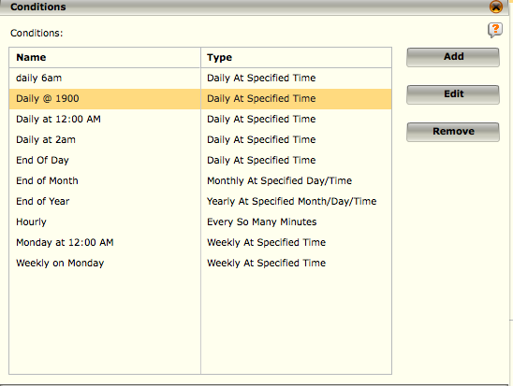
Report Conditions
Conditions can be thought of as triggers that cause a report to be generated when a specified criterion is met.
There are set conditions that come with the system but you can define new conditions on the Add Condition screen.
Notes:
To add a condition:
1. Click on the Conditions button located near the bottom of the Reports dialog (System Properties > Reports) or on Edit conditions in Section 2 of the Add Report dialog. The Conditions dialog will open.
2. Click the Add button. The Add Condition screen opens.
3. Type in a name for the condition.
4. Click on the arrow in the Type field and select the condition type from the drop-down list. The options are:
• Daily at Specified Time - Same time on a daily basis.
• Every So Many Minutes - Every number of minutes specified.
• Hourly at Specified Minute - Once an hour at the specified minute.
• Weekly at Specified Time - Same time on a weekly basis.
• Monthly at Specified Day/Time - Same time on a monthly basis.
• Yearly at Specified Month/Day/Time - Same time on a yearly basis.
5. Specify the trigger time properties of the condition in the Properties section. These property options will change based on the condition type selected.
6. Click OK to save your changes and the new condition will appear in the Conditions screen.
To modify a condition:
1. Select the specific condition to be modified from the list of conditions on the Conditions screen (System Properties > Reports > Conditions).
2. Click the Edit button. The Edit Condition dialog will open.
3. Make the desired modifications to the settings.
4. Click OK to save your changes.
Continued on next page

Slide 18
Hidden
Notes:
Delete a Condition
One or more conditions can be deleted from the system. To do so:
1. Select one or more conditions on the Conditions screen (System Properties > Reports > Conditions).
2. Click on the Remove button. The Remove Condition dialog will appear requesting confirmation.
3. Click Yes to proceed with the removal or No to cancel the removal.

Slide 19
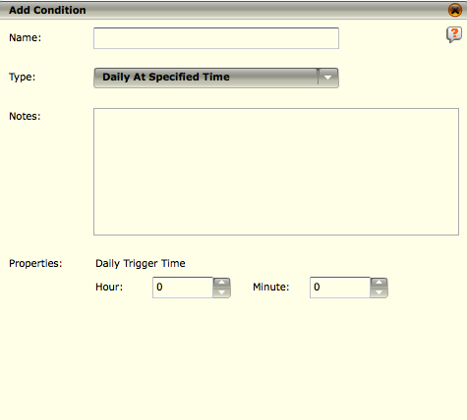
Add a Condition
The default condition types are:
Daily at Specified Time - Same time on a daily basis.
Every So Many Minutes - Every number of minutes specified.
Hourly at Specified Minute - Once an hour at the specified minute.
Weekly at Specified Time - Same time on a weekly basis.
Monthly at Specified Day/Time - Same time on a monthly basis.
Yearly at Specified Month/Day/Time - Same time on a yearly bas
Notes:
For each type of condition, you have to define the properties. They vary based on the condition type chosen.

Slide 20
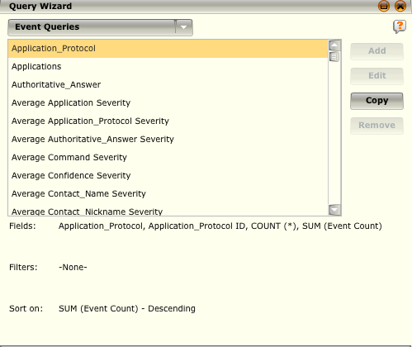
Query Wizard
When you drag and drop a component into the Report Layout the Query Wizard dialog will pop up
The Query Wizard allows you to edit or remove a custom query, and copy a custom or predefined query to define a new custom query.
If you have added any custom types, they will be displayed in the list of queries available

Slide 21
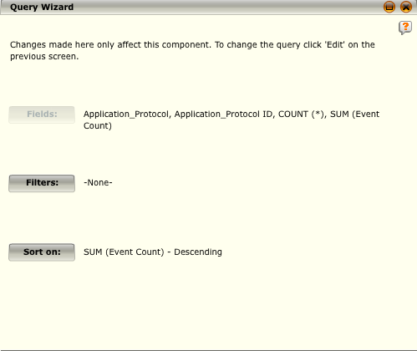
Query Wizard Cont.
The second dialog within the query wizard allows you to specify:
Filters - The Filters button allows you to set up filter values or create data binding for your view
Sort on - The Sort On button allows you to specify how the query should order its results. You may choose what to sort on first, second, third, and last. You can also specify if you want the information sorted in ascending or descending order.

Slide 22
UCF Report Filter
One of the challenges for regulation compliance support is the ever-changing nature of regulations.
Unified Compliance Framework (UCF) is an organization that maps the specifics of each regulation to harmonized control IDs.
As regulations change, these IDs are updated and pushed to the McAfee ESM.
The Compliance ID filter option allows you to select the required compliance or specific subcomponents and apply the filter so that only the appropriate events are displayed.
Notes:
1.Click on the filter icon to the right of the Compliance ID field in Section 6 of the Add Report window. The Filter Variables dialog opens.
2.Select the compliance value(s) by which you want to filter.
3.Click OK. The Filter Variables dialog will close and the UCF IDs will be added to the Compliance ID field.

Slide 23
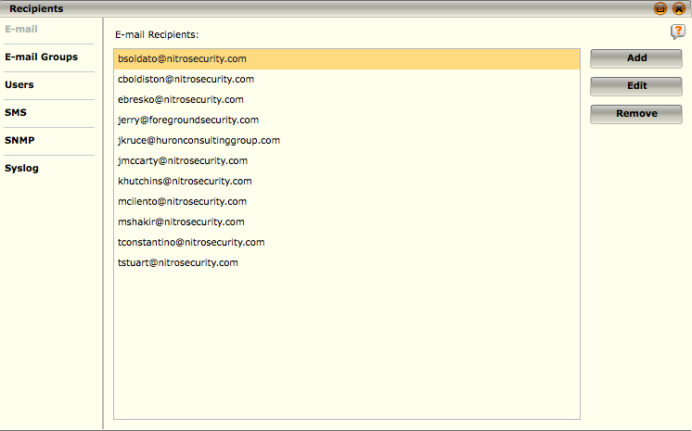
Email Report Recipients
The Recipients option allows you to define who should receive the reports to be generated and the format in which you want them sent.
Notes:
The Recipients option on the Reports dialog allows you to manage email addresses. When you click on it, the Recipients dialog opens.
Add Email Recipients
1. Click Add on the Recipients screen (System Properties > Reports > Recipients). The Add Email Recipient dialog appears.
2. Enter the desired email address.
3. Click OK. The email address will be added to the Email Recipients list.
Edit an Email Recipient
1.On the Recipients screen (System Properties > Reports > Recipients), click on the email address to be modified.
2.Click Edit. The Edit Email Recipient dialog appears.
3.Make the necessary modifications to the address.
4.Click OK to save the changes.
Remove an Email Recipient
1. Highlight the address(es) you wish to remove on the Email Recipients list (System Properties > Reports > Recipients).
2. Click on the Remove button. A Remove Email Recipient dialog will appear requesting confirmation.
3. Click Yes to proceed with the removal or No to cancel the removal.

Slide 24
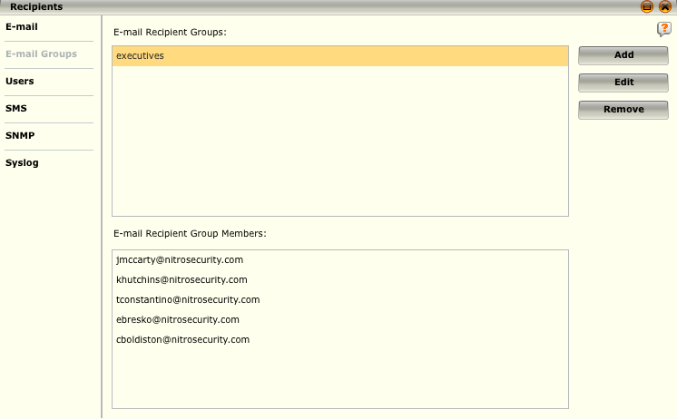
Email Report Groups
The Email Group option allows you to group email addresses.
This is useful when sending an email to several people multiple times a week.
By including one or more email addresses in an email group, you can mass mail messages to all members of this group by simply attaching the group to the message instead of attaching each email address individually.
Notes:
To configure an email group:
Click on the Email Groups option on the Recipients screen (System Properties > Email Settings > Configure Recipients). The Email Recipients Groups screen will open.
Click Add. The Add Email Recipient Group dialog appears.
Type in the name of the new group in the Email Group Name field.
Select the email addresses you want to include in the group. You can also use the Select All and Select None buttons to select all or none of the email addresses.
Click OK to save your settings. The new group will be added to the list of Email Recipient Groups on the Recipients screen.
To edit a group:
Click on the group you want to modify on the Recipients > Email Groups screen (System Properties > Email Settings > Configure Recipients).
Click Edit. The Edit Email Recipient Group dialog opens.
Make the necessary changes.
Click OK to save your changes.
To remove one or more groups:
Click on the group(s) you wish to remove on the Recipients > Email Groups screen (System Properties > Email Settings > Configure Recipients).
Click on Remove. A dialog will appear requesting confirmation.
Click Yes to proceed with the removal or No to cancel the removal.

Slide 25
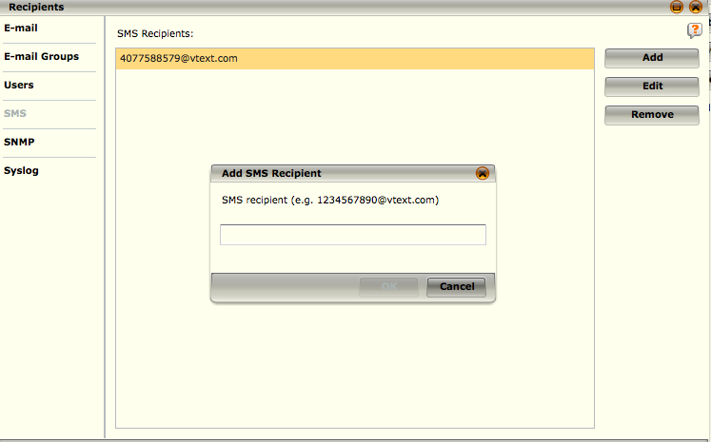
SMS Report Recipients
The ESMI provides you with the ability to send SMS (text) messages.
Notes:
To add SMS addresses to the system so they will be available to select when you are defining the recipients for a report, do the following:
On the Recipients screen (System Properties > Reports > Recipients), click on SMS. The SMS Recipients dialog opens listing all of SMS addresses currently on the system.
Click on Add. The Add SMS Recipient dialog opens.
Enter the SMS address that you want to add to the system. Refer to the SMS Recipients section under Email Settings for the format you would need to use for the more common SMS service providers.
Click OK. The address will be added to the list of SMS recipients.
You can edit or remove these addresses by highlighting an address and clicking on Edit or Remove on the SMS Recipients dialog.

Slide 26
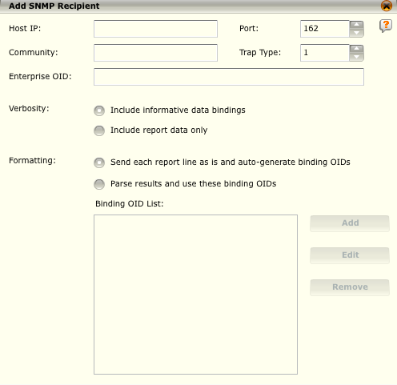
SNMP Reports Recipients
The McAfee ESM can send alarm notifications via the SNMPv1 protocol.
SNMP uses User Datagram Protocol (UDP) as the transport protocol for passing data between managers and agents.
In a typical SNMP setup, an agent such as the ESM can send an SNMP server (usually referred to as a Network Management Station [NMS]) events using packets of data known as traps.
This can be useful when a system administrator wants to receive event reports from the ESM in the same way notifications are received from other agents in the network.
Notes:
Add a SNMP recipient:
1.Select SNMP on the Recipients screen (System Properties > Email Settings > Configure Recipients). The SNMP Recipients list appears.
2.Click the Add button. The Add SNMP Recipient dialog appears.
3.Enter the correct values for the following fields to direct the packet to its destination and provide information useful to system administrators using SNMP:
• Host IP - The IP address of the machine to which the trap will be sent.
• Port - The port on which the SNMP trap is to be received.
• Community - The SNMP trap's community string.
• Trap Type - The specific trap type (the general trap type is always set to 6, Enterprise Specific).
• Enterprise OID - The full enterprise OID for the trap to be sent: everything in the trap's OID from the first 1 to the enterprise number, including any subtrees within the enterprise.
• Verbosity - When Include Informative Data Bindings is selected, the trap will contain variable bindings with extra information, including the line number of the report being processed, a 'McAfee' string identifying the source of the trap, the name of the notification generating the trap, and the ID of the ESM sending the trap. When Include report data only is selected, these extra variable bindings are not included in the trap.
• Formatting - Each SNMP trap generated from a report contains one line of data from that report. When you select Send each report line as is..., the data from the report line is sent as is in a single variable binding, with the data binding OIDs being constructed by concatenating the Enterprise OID, the specific trap type, and an auto-incrementing number beginning at 1. When Parse results and use these binding OIDs is selected, the report line will be parsed and each field will be sent in a separate data binding. Selecting this option allows you to specify custom data binding OIDs. If you do not specify enough variable OIDs for all the data fields in the report, the ESMI will begin incrementing from the last OID specified in the list.
Continued on next page

Slide 27
Hidden
Notes:
4.Once the values have been added, click Add. The Binding OID dialog will open.
5.Enter the binding OID value and click OK. The binding OID number will appear on the Binding OID List.
6.Click OK. The SNMP recipient will be added to the SNMP Recipients list.
Edit a SNMP Recipient
1.Click on the recipient you want to modify on the Recipients > SNMP Recipients screen (System Properties > Email Settings > Configure Recipients).
2.Click Edit. The Edit SNMP Recipient dialog opens.
3.Make the necessary changes (see Add SNMP Recipients for details).
4.Click OK to save your changes.
Remove a SNMP Recipient
1.Click on the SNMP recipient(s) you want to remove on the Recipients > SNMP Recipients screen (System Properties > Email Settings > Configure Recipients).
2.Click on Remove. A dialog will appear requesting confirmation.
3.Click Yes to proceed with the removal or No to cancel the removal.

Slide 28
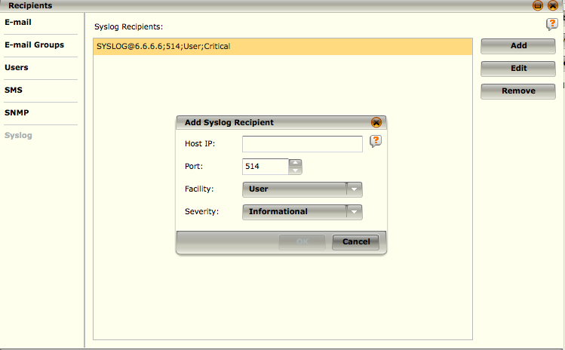
Syslog Report Recipients
Syslog is a standard for forwarding log messages in an IP network.
The syslog protocol is simple: a sender sends a small textual message to a syslog, often referred to as "syslogd," "syslog daemon," or "syslog server.”
Notes:
Add a Syslog Recipient
1.Click the Syslog option on the Recipients screen(System Properties > Email Settings > Configure Recipients). The list of Syslog Recipients will appear.
2.Click on the Add or Edit button. The Add Syslog Recipient or Edit Syslog Recipient dialog appears.
3.Enter or modify the recipient’s host IP and the port.
4.Specify or modify the facility and the severity by clicking on the down arrows.
5.Click OK to add the information to the Syslog Recipient List.
To remove a syslog recipient, complete the following.
1.Click on the syslog recipient(s) you wish to remove.
2.Click on the Remove button. The Remove Syslog Recipient dialog will appear requesting confirmation.
3.Click Yes to proceed with the removal or No to cancel the removal.

Slide 29
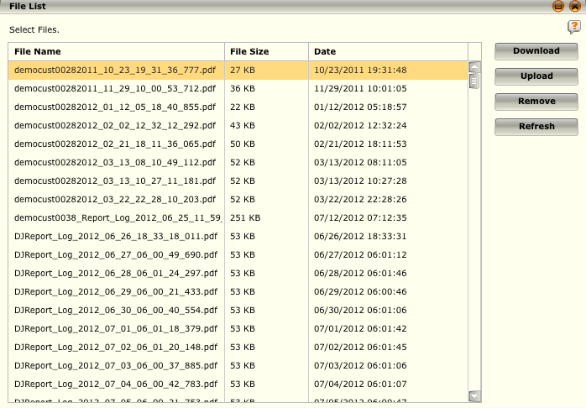
View Report Files
The Files feature on the Reports screen allows you to view a list of the report files that have been generated on the system and download, upload, or remove them.
Notes:
View Report Files
The Files feature on the Reports screen allows you to view a list of the report files that have been generated on the system and download, upload, or remove them. To use this feature, do the following:
Access the report File List screen (System Properties > Reports > Files).
Select one or more of the report file(s) on the list. You can click on the column headers to sort through the queue.
Perform the desired actions:
Click on the Download button to save the selected file(s) to another location. You can then view the file(s).
Click on the Upload button to add a report file to the list. This could be useful if you downloaded a file, removed it from the system, and then realized that you wanted to keep it on the list of reports.
Click on the Remove button to delete the selected report file(s) from the system. Keep in mind that once a file is deleted it cannot be restored unless it was downloaded to a separate location previously.
Click on the Refresh button to refresh the list of reports.
Click Close to return to the Reports screen.

Slide 30
Reports can be delivered in what formats?
HTML
PDF
Plain Text
CSV
Rich Text
Notes:
Answer: HTML, PDF, and CSV

Slide 31
The default time zone used in reporting is GMT.
True
False
Notes:
Answer: False – The default time zone is the time zone configured in the ESM as your time zone.

Slide 32
Reports can only be sent to email recipients that have valid user accounts defined with reporting privileges within the ESM assigned?
True
False
Notes:
Answer: False – Reports can be sent to any valid email address.

Slide 33
Hands-on Practice Refer to the Practice Manual Practice 10: Reporting

